Slide 1



CLOUD STRATEGY FOR FASHION HUB BOUTIQUE
Group #4

Slide 2


Overview
Introduction
03
Enterprize Background
04
Business Size
05
Core Operations
06
Current IT Setup
07
Recommendations
08
Justifications
10
Cost Analysis
11
Demo
15

Slide 3

INTRODUCTION
Comprehensive Cloud Strategy for Fashion Hub Boutique
Enhancing IT Infrastructure for Operational Excellence
Presented by:
Syed Taimoor Ali Shah
Muhammad Marghoob Ahmed
Pappala Sandeep
Venkata Subbarao Tumati

Slide 4

Enterprise Background
Company Overview
Fashion Hub Boutique operates in the upscale retail clothing and accessories industry, with five boutique stores located in major cities and a successful e-commerce platform. The company focuses on delivering personalized shopping experiences, maintaining robust inventory management, and employing strategic marketing campaigns.
Industry: High-end retail fashion
Offerings: Upscale clothing, luxury handbags, exquisite jewelry, custom accessories
Focus: Superior customer experience with personalized service
Physical Locations: 5 upscale retail stores in major cities
Online Presence: Successful e-commerce platform

Slide 5

Business Size
Employees: 50 full-time workforce individuals, which include income buddies, managers, and administrative personnel.
Locations: Five boutique shops placed in most important cities.
Revenue: An annual revenue of about $10 million.

Slide 6

Core Operations
Sales
Inventory
Marketing
E-commerce
Delivering exceptional in-store and online shopping experiences with personalized customer service.
Using advanced systems to ensure a constant supply of high-end designer products at all locations.
Executing targeted campaigns through digital and traditional channels to attract and retain upscale customers.
Providing a seamless online shopping platform with secure payment methods and efficient order fulfilment.

Slide 7



Current IT Setup
Hardware
Software
Network Architecture
Includes two on-premises servers, thirty desktop PCs, twenty laptops, and seventy-five POS systems across five locations.
Windows Server 2016, Windows 10, QuickBooks, Microsoft Office Suite, and Magento for e-commerce.
Comprises Cisco routers and switches, Fortinet firewalls, and VPN for secure and reliable connectivity.

Slide 8




Recommendations
Adopting cloud solutions such as IaaS for servers, cloud storage for scalable data management, hybrid networking for flexibility, SaaS for software applications, and comprehensive cost analysis for financial planning and optimization.
Servers and Compute Resources
Storage Solutions
Networking
Implement cloud storage (e.g., Amazon S3 or Azure Blob Storage) for enhanced scalability, data security, and accessibility.
Adopt a hybrid networking solution to integrate on-premises infrastructure with cloud capabilities for flexibility and scalability.
Transition to IaaS (e.g., Amazon EC2 or Azure Virtual Machines) for scalable computing and reduced maintenance.

Slide 9


Recommendations
Adopting cloud solutions such as IaaS for servers, cloud storage for scalable data management, hybrid networking for flexibility, SaaS for software applications, and comprehensive cost analysis for financial planning and optimization.
Applications and Software
Cost Analysis
Estimate monthly costs for cloud services, backup options (e.g., AWS Glacier, Azure Backup), and monitoring tools (e.g., AWS CloudWatch, Azure Monitor) to optimize financial planning and resource allocation.
Shift to SaaS solutions (e.g., Office 365, QuickBooks Online) for improved productivity, reduced IT burden, and enhanced accessibility.

Slide 10

01
IaaS offers scalability and cost-efficiency by eliminating upfront hardware costs and enabling rapid resource provisioning.
02
Cloud storage ensures scalability, data redundancy, and global accessibility while reducing the burden of managing physical storage infrastructure.
Justifications
03
Hybrid networking allows seamless integration of existing on-premises systems with scalable cloud services, optimizing performance and flexibility.
04
SaaS solutions enhance accessibility, ensure regular updates, and reduce IT maintenance efforts, fostering operational efficiency.
05
Conducting a thorough cost analysis enables effective budgeting, identifies cost-saving opportunities, and ensures resource allocation aligns with business priorities.

Slide 11
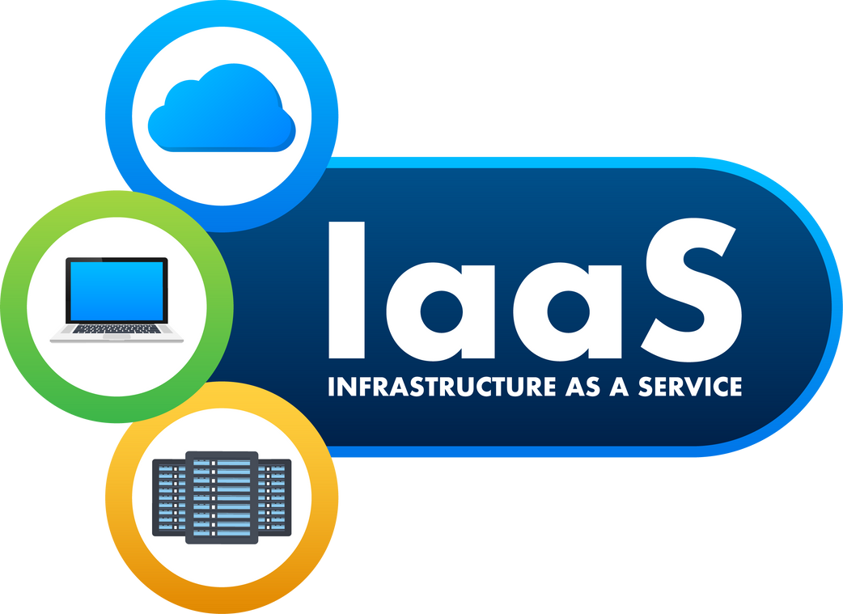

COST ANALYSIS
Compute Resources
Storage Solutions
Amazon EC2: Approx. $200/month for a small instance.
Azure VMs: Approx. $210/month for a similar configuration.
Amazon S3: Approx. $50/month for 1TB storage.
Azure Blob Storage: Approx. $48/month for 1TB storage.

Slide 12

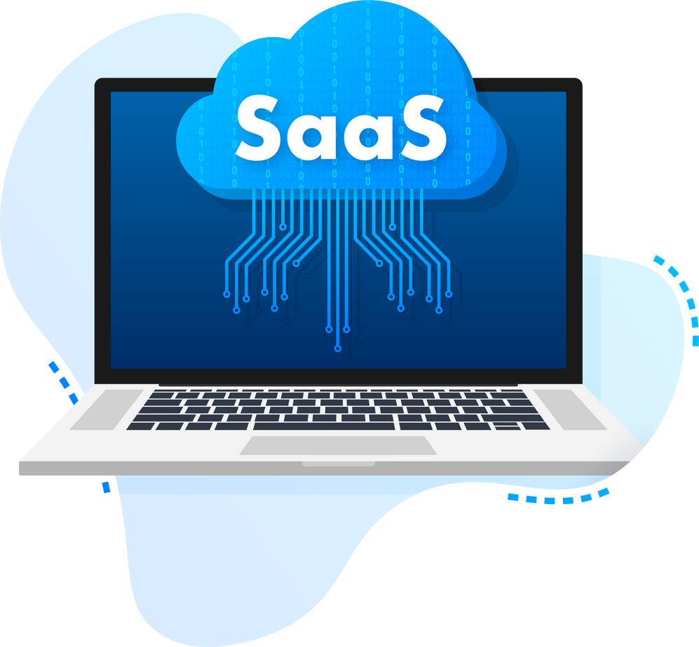
COST ANALYSIS
Applications and Software
Networking
AWS VPC: Included in the cost of EC2.
Azure Virtual Network: Included in the cost of VMs.
Office 365: $7.5/user/month. For 50 users: $375/month.
QuickBooks Online: $70/month for the essentials plan.

Slide 13
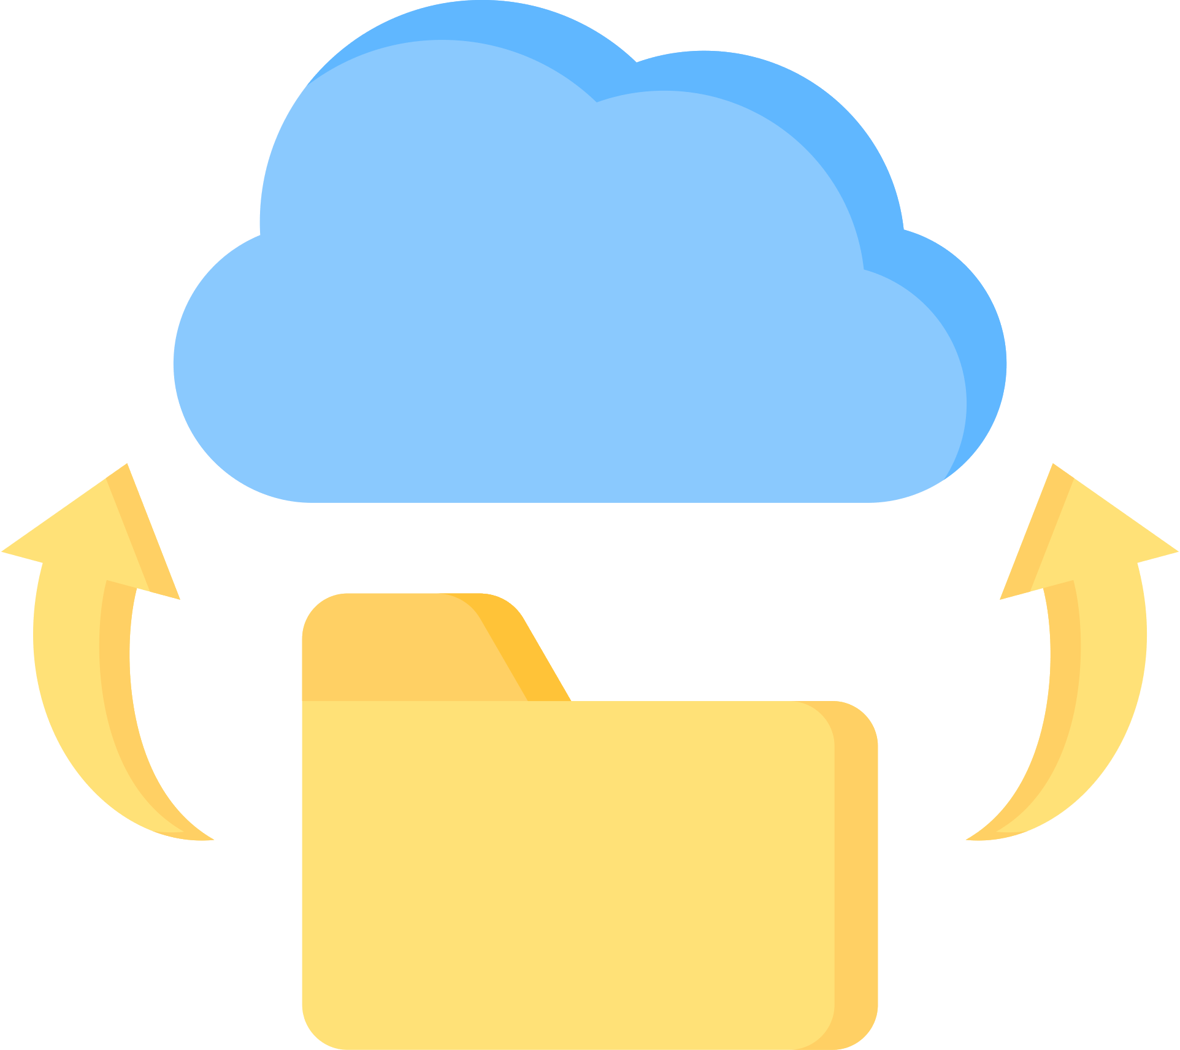

COST ANALYSIS
Monitoring and Management
Backup Options
Amazon S3 Glacier: Approx. $4/month for 1TB for long-term backup.
Azure Backup: Approx. $5/month for 1TB backup.
AWS CloudWatch: Approx. $10/month for basic monitoring.
Azure Monitor: Approx. $15/month for basic monitoring.

Slide 14


TOTAL ESTIMATED MONTHLY COST
AWS
Azure
$
639/M
$
348/M

Slide 15


DEMO

Slide 16
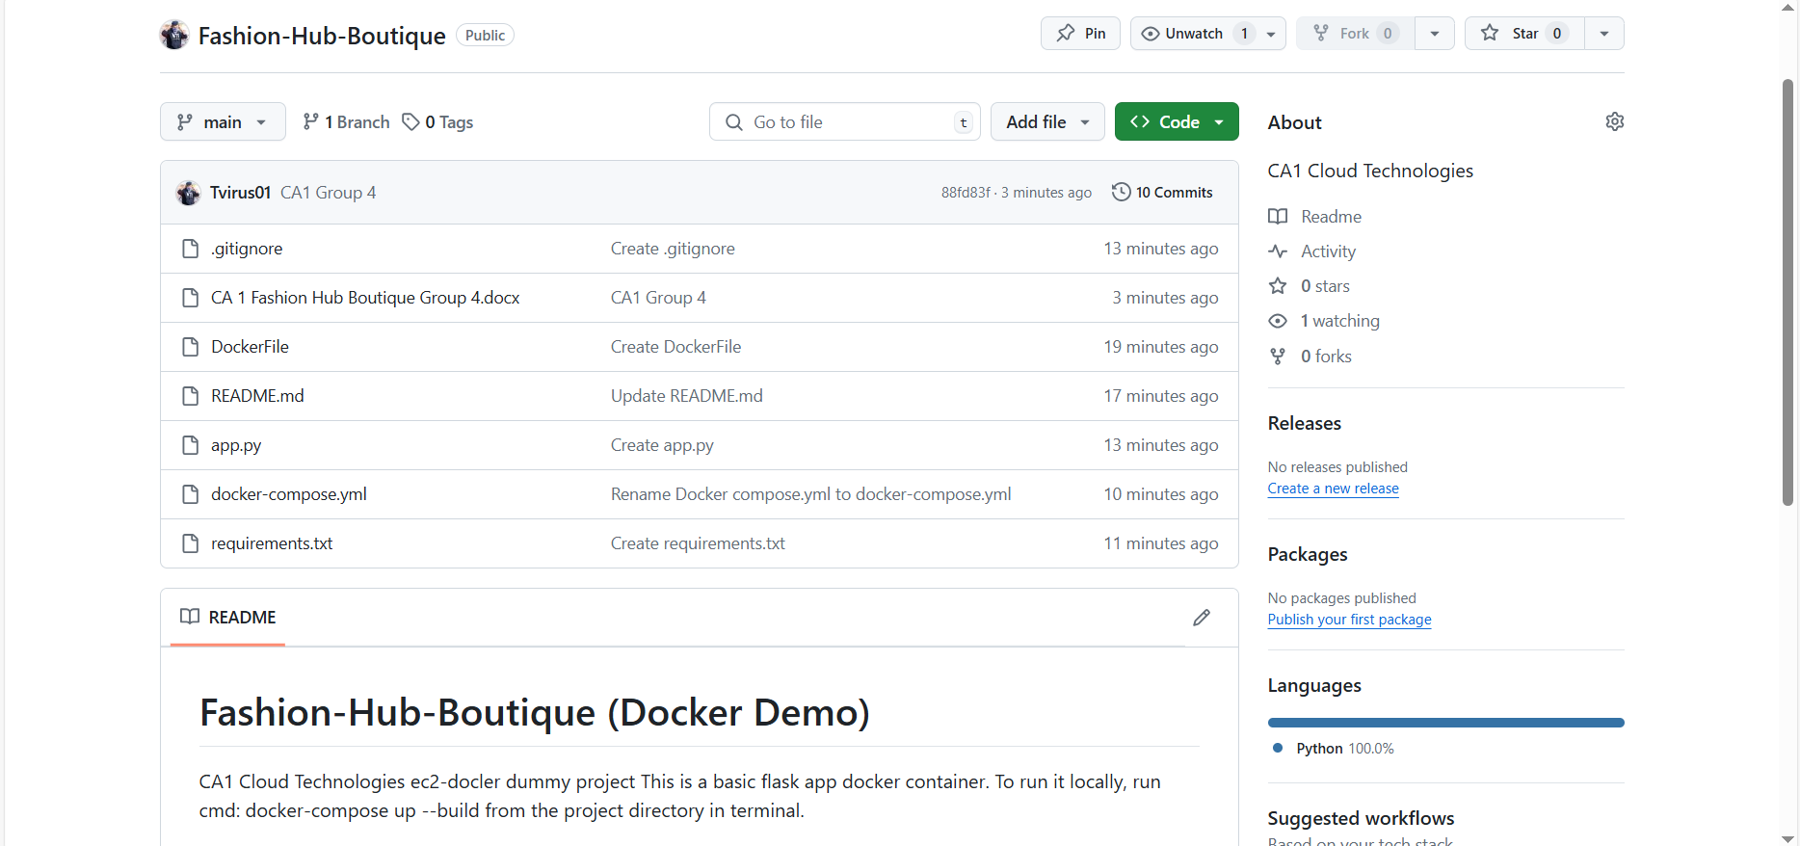
GitHub Setup

Slide 17
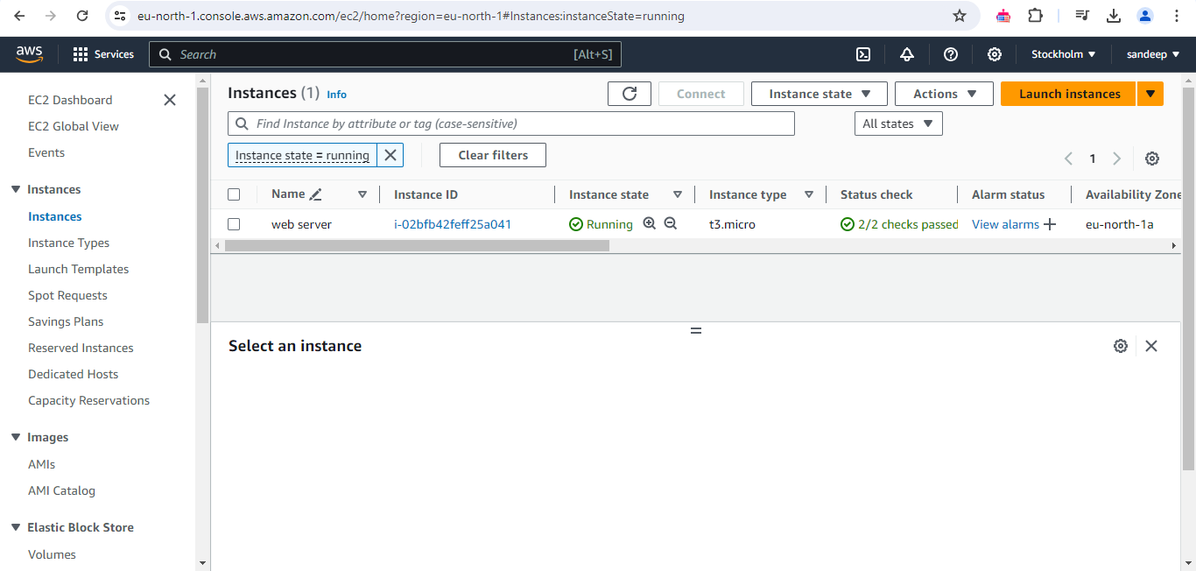
Create VPC

Slide 18
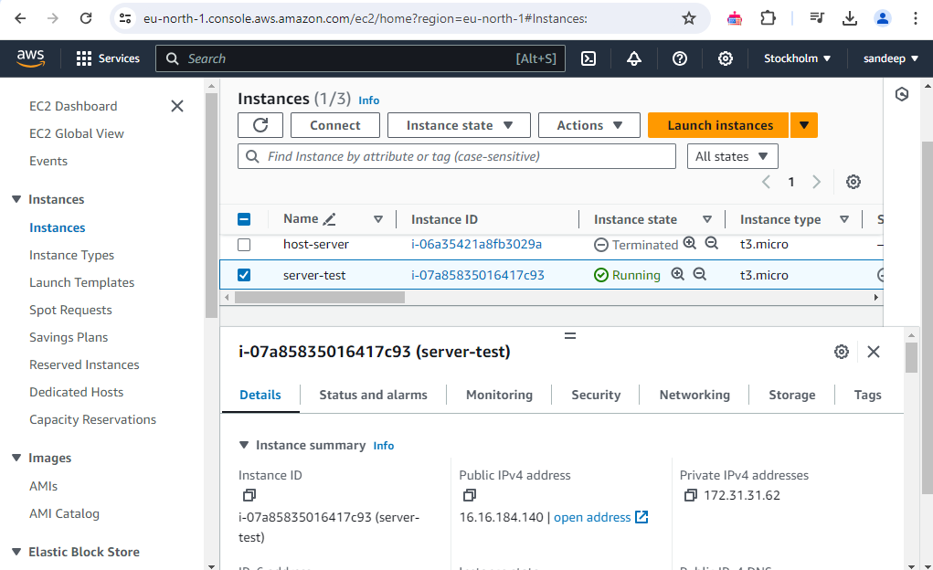
Launch EC2 Instances

Slide 19
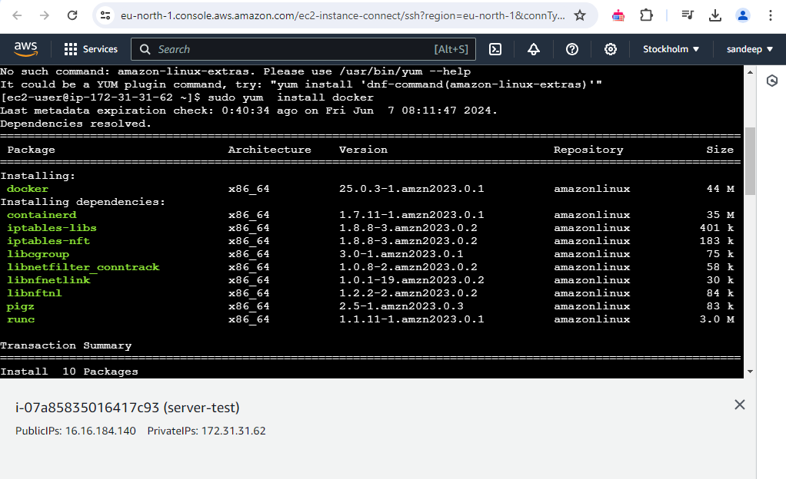
Install Docker and Set Up Containers

Slide 20
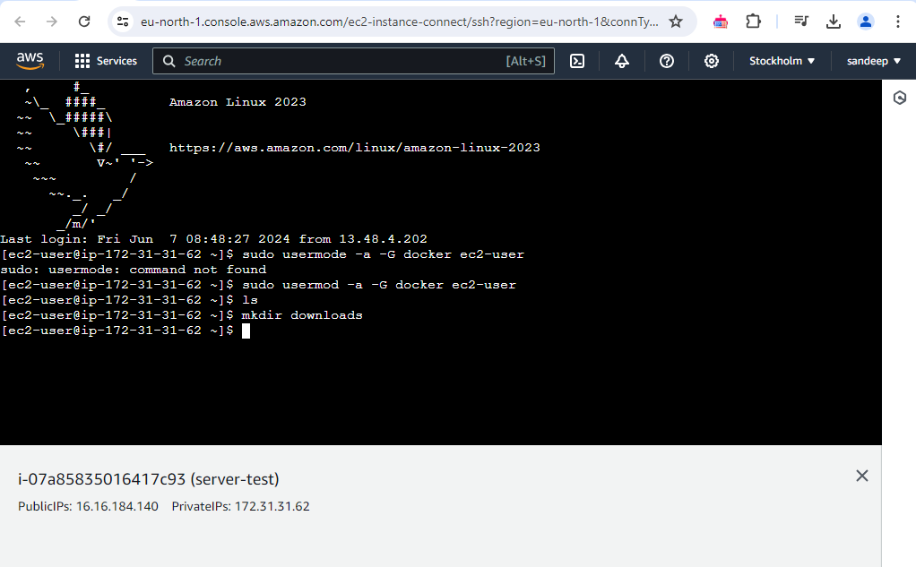
Install Docker and Set Up Containers

Slide 21
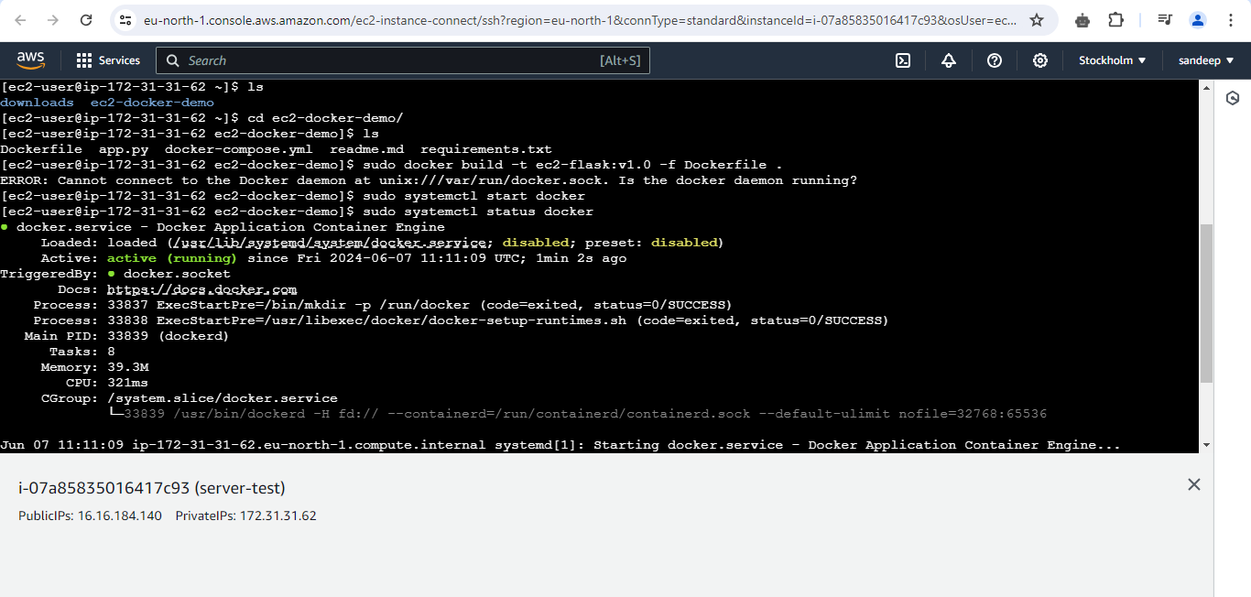
Check Docker Status

Slide 22
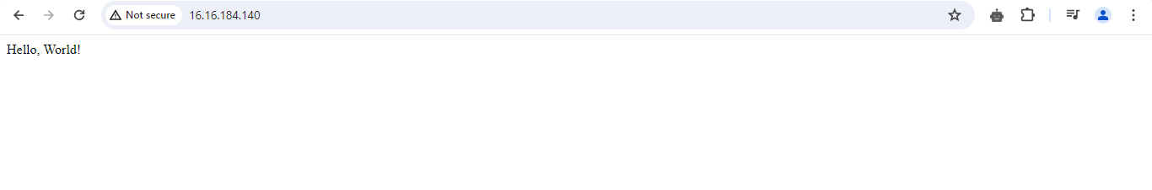
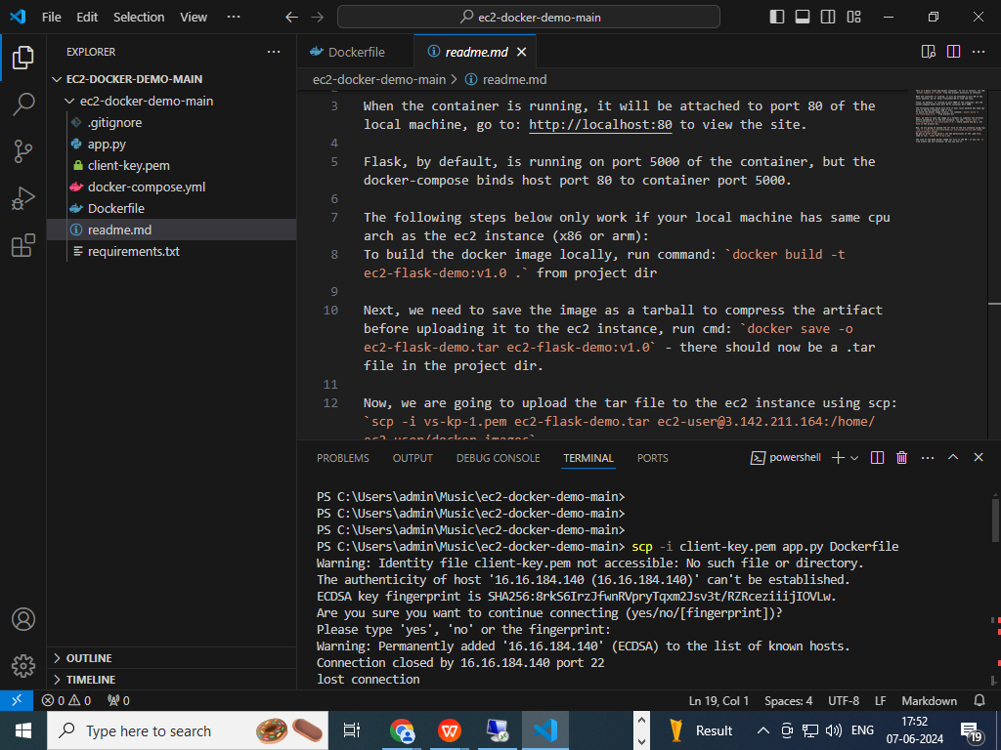
Check if Application Successfully deployed

Slide 23




OUR TEAM
Syed Taimoor Ali Shah
20027698
Muhammad Marghoob Ahmed
20036283
Pappala Sandeep
20028293
Venkata Subbarao Tumati
20017250

Slide 24



THANK YOU!
ANY QUESTIONS?

